Slide 1
technical, economic, financial plans
Johann Binder Pula, 27.11.2014

Slide 2
technical, economic, financial plans
Outputs
1 framework for elaboration of technical, economic & financial plans
1 catalogue of investment opportunities
11 local technical, economic & financial plans
11 reports on pilot investment designs
3 pilot investments

Slide 3
technical, economic, financial plans
Framework document
Strategic planning (regional strategy)
Set up criteria
Processing criteria
Implementation criteria
Evaluation criteria

Slide 4
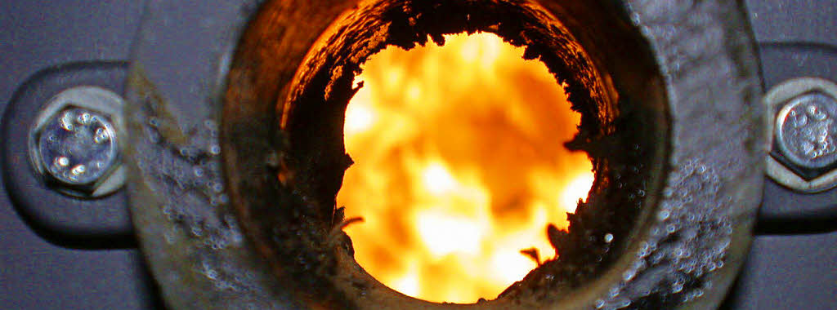
technical, economic, financial plans
Framework document
Technical descriptions
Wood chip systems
Biogas plants
Biomass gasification plants
Solar heating systems
Photovoltaik plants
Hydro power plants
Wind power plants
Geothermal energy plants

Slide 5
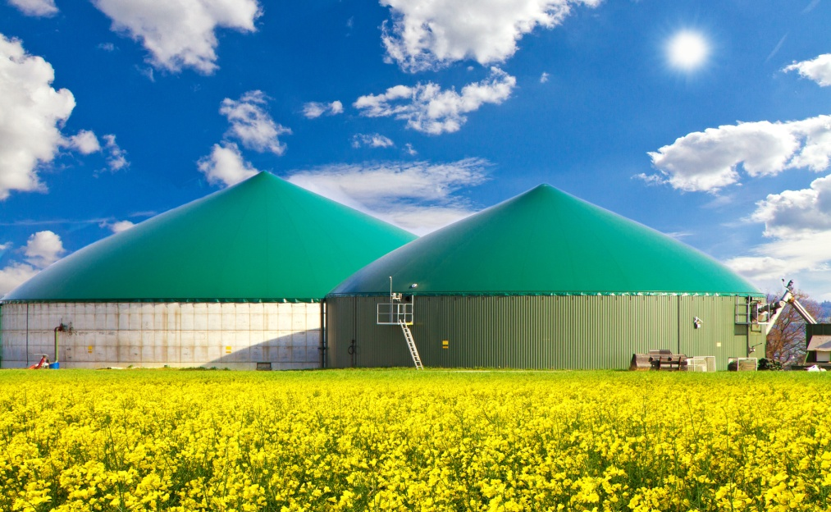
technical, economic, financial plans
Framework document
Technical descriptions
Wood chip systems
Biogas plants
Biomass gasification plants
Solar heating systems
Photovoltaik plants
Hydro power plants
Wind power plants
Geothermal energy plants

Slide 6
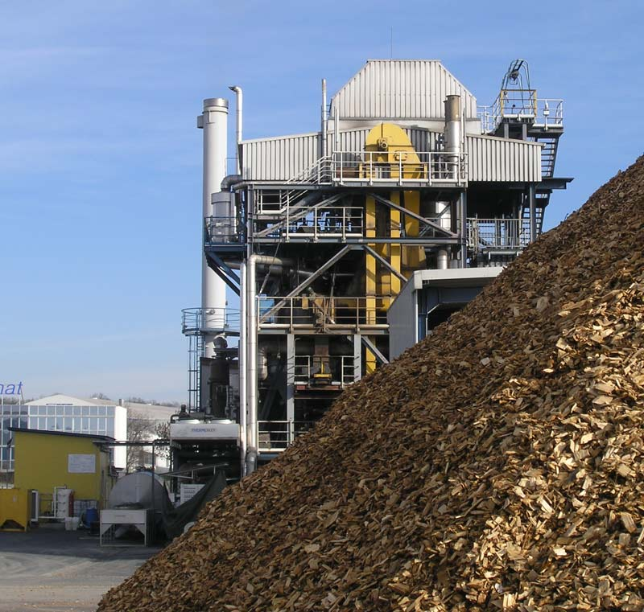
technical, economic, financial plans
Framework document
Technical descriptions
Wood chip systems
Biogas plants
Biomass gasification plants
Solar heating systems
Photovoltaik plants
Hydro power plants
Wind power plants
Geothermal energy plants

Slide 7
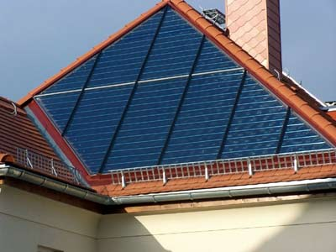
technical, economic, financial plans
Framework document
Technical descriptions
Wood chip systems
Biogas plants
Biomass gasification plants
Solar heating systems
Photovoltaik plants
Hydro power plants
Wind power plants
Geothermal energy plants

Slide 8
technical, economic, financial plans
Framework document
Technical descriptions
Wood chip systems
Biogas plants
Biomass gasification plants
Solar heating systems
Photovoltaik plants
Hydro power plants
Wind power plants
Geothermal energy plants

Slide 9
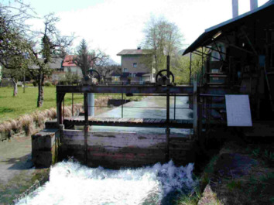
technical, economic, financial plans
Framework document
Technical descriptions
Wood chip systems
Biogas plants
Biomass gasification plants
Solar heating systems
Photovoltaik plants
Hydro power plants
Wind power plants
Geothermal energy plants

Slide 10
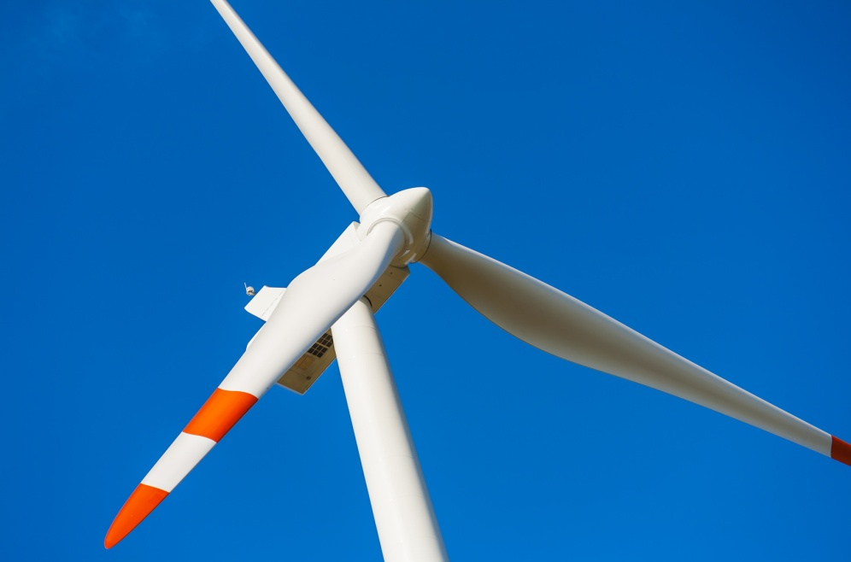
technical, economic, financial plans
Framework document
Technical descriptions
Wood chip systems
Biogas plants
Biomass gasification plants
Solar heating systems
Photovoltaik plants
Hydro power plants
Wind power plants
Geothermal energy plants

Slide 11
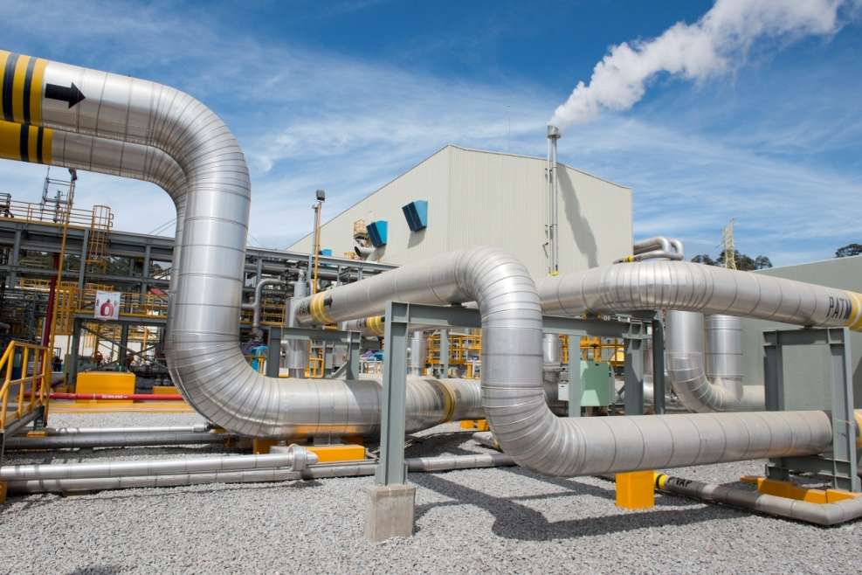
technical, economic, financial plans
Framework document
Technical descriptions
Wood chip systems
Biogas plants
Biomass gasification plants
Solar heating systems
Photovoltaik plants
Hydro power plants
Wind power plants
Geothermal energy plants

Slide 12
technical, economic, financial plans
Framework document
Economic Evaluation of energy plants
Cost comparison method
Profit comparison method
Profitability calculation
Payback period rule
Present value method
Internal rate of return method
Annuity method

Slide 13
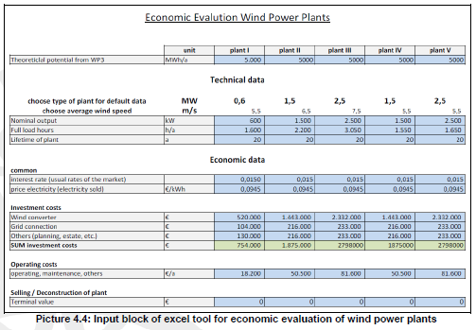
technical, economic, financial plans
Framework document
Calculation tool for economic feasibility

Slide 14
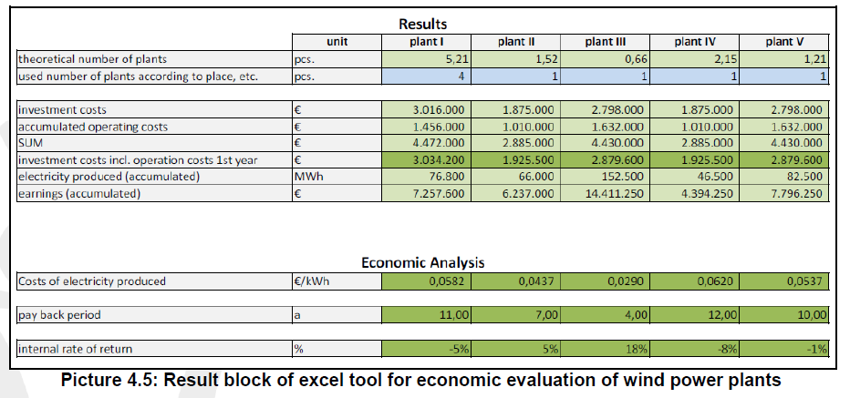
technical, economic, financial plans
Framework document
Calculation tool for economic feasibility

Slide 15
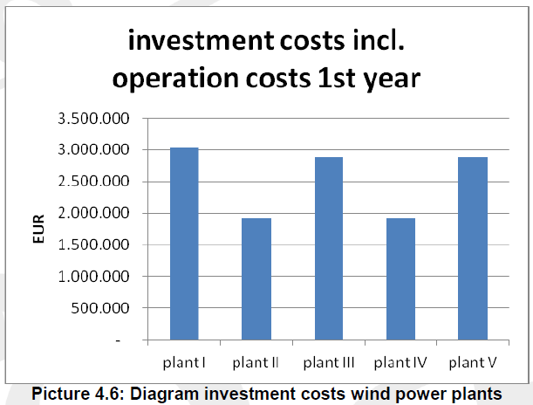
technical, economic, financial plans
Framework document
Calculation tool for economic feasibility

Slide 16
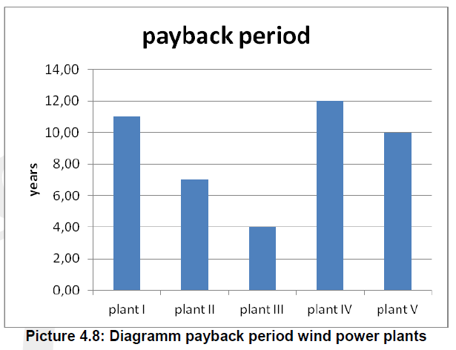
technical, economic, financial plans
Framework document
Calculation tool for economic feasibility

Slide 17
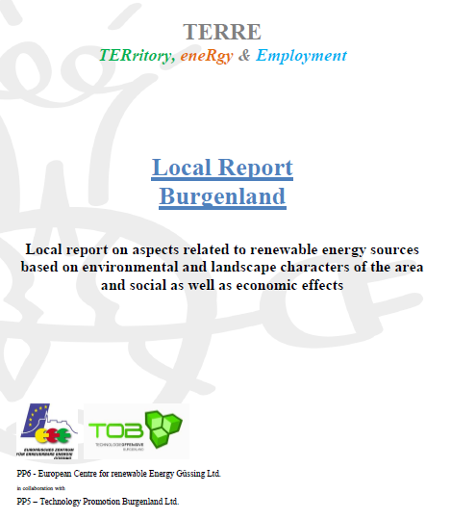
technical, economic, financial plans
11 strategic documents

Slide 18
technical, economic, financial plans
Pilot Investments
3 project partner show up pilot investments
town Odorheiu Secuiesc (RO)
IRENA - Istrian Regional Energy Agency
LIR Evolution

Slide 19
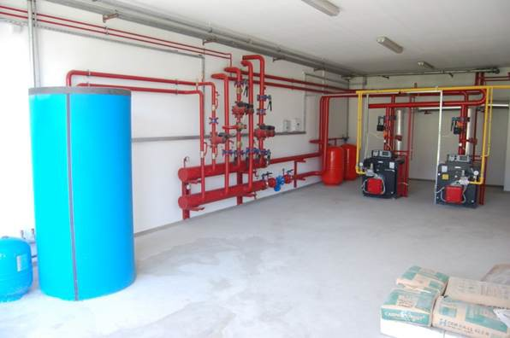
technical, economic, financial plans
Pilot Investments
Community Odorheiu Secuiesc (RO)
Biomass heating system
Vocational school
Costs 50.000,-- EURO

Slide 20
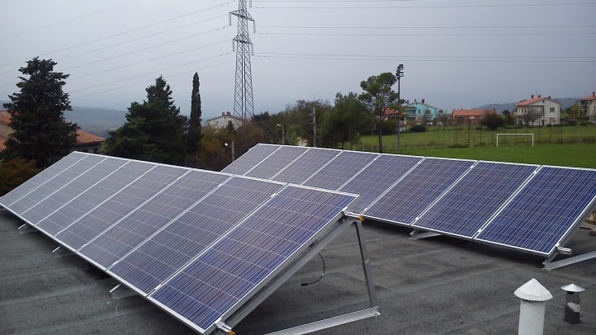
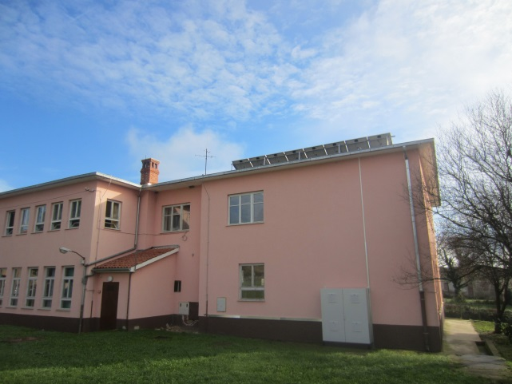
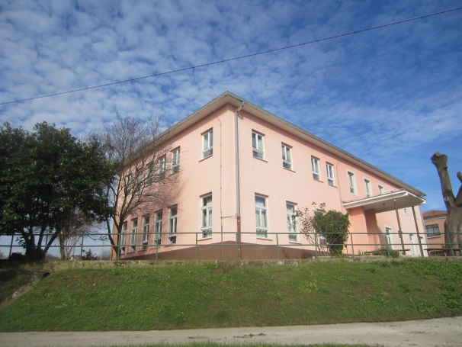
IRENA – Istrian Regional Energy Agency Ltd. Small scale investment: FV solar plant of 6 kW
technical, economic, financial plans
Pilot Investments
Country: Croatia
Region: Region of Istria
Location of pilot project: Čepić field - Elementary school Ivan Goran Kovačić
Budget: 23.380,24 EUR
Average el. production of the plant: 7.507,00 kWh/a

Slide 21
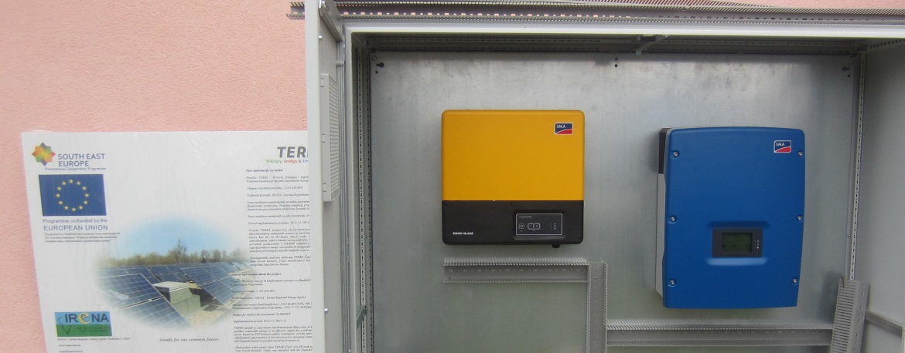
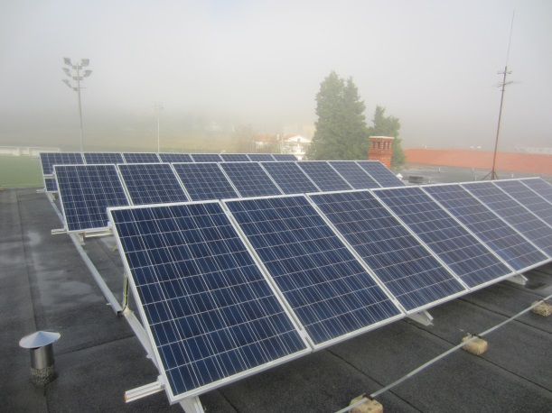
IRENA – Istrian Regional Energy Agency Ltd. Small scale investment: FV solar plant of 6 kW
Main components:
Photovoltaic modules (24 module unit power 250 Wp – total power 6 kW)
Grid power inverter el.en. (DC / AC inverter)
Bidirectional power inverter (AC / DC and DC / AC) and batteries,
Main distributor cabinet (GRO)
cabinet for accommodation of active power equipment,
surveillance and communication equipment,
external lightning protection system-LPS.

Slide 22
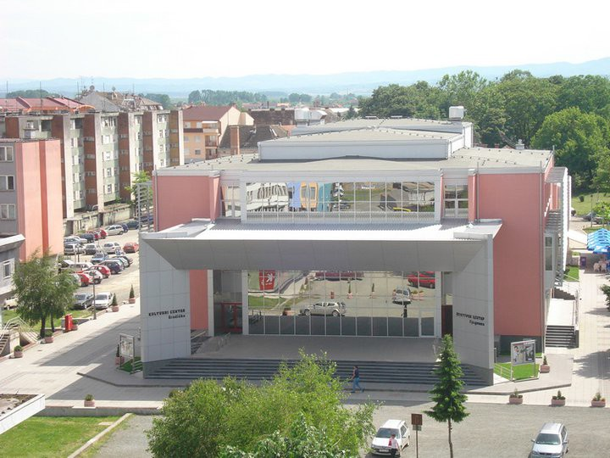
technical, economic, financial plans
Pilot Investments
LIR Evolution (BiH)
Photovoltaic plant
Power 5 kW
Costs 14.400,-- EURO

Slide 23
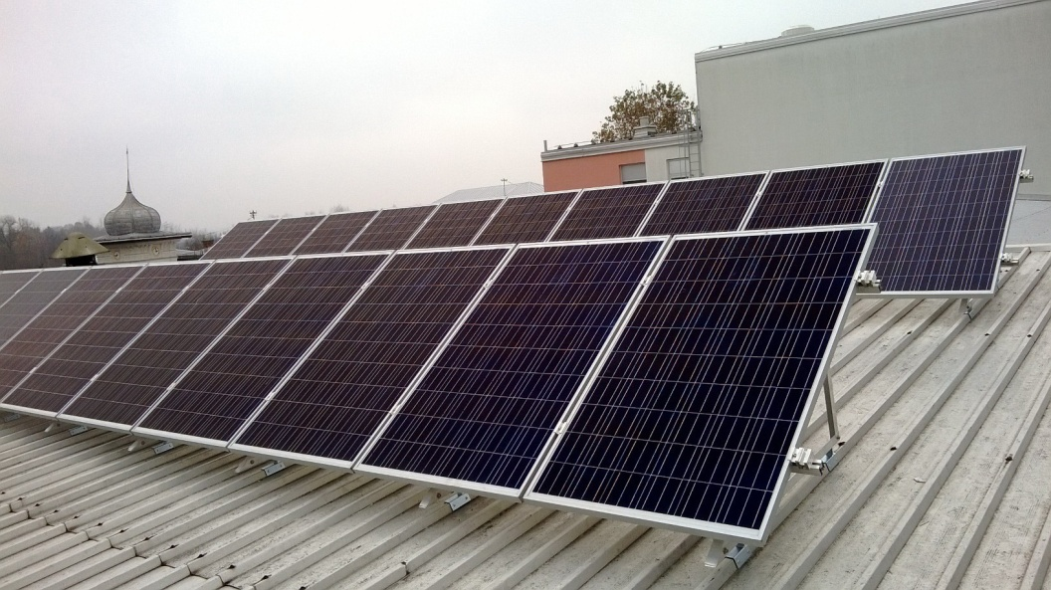
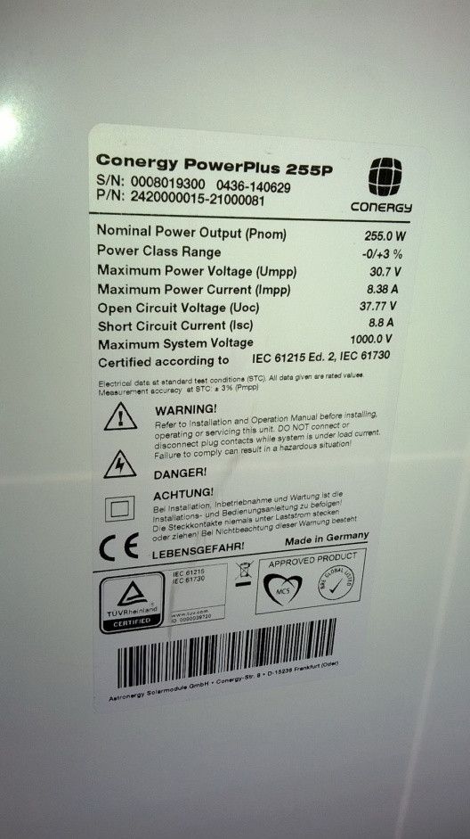
technical, economic, financial plans
Pilot Investments
LIR Evolution (BiH)
Opening in Gradiska 25.11.2015
3rd TERRE Seminar
demonstrative value for raising awareness

Slide 24
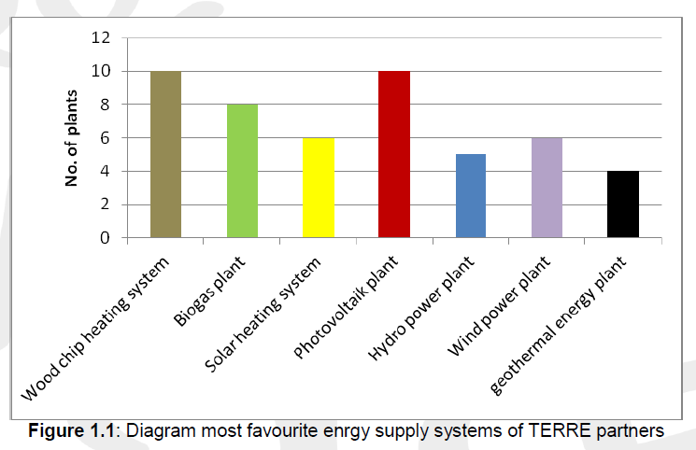
technical, economic, financial plans
Catalogue of investment opportunities
Analysis of questionaire

Slide 25
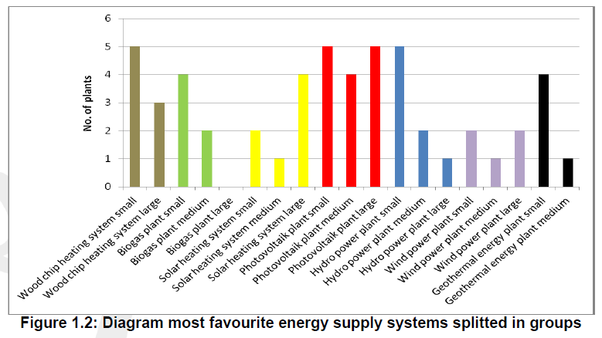
technical, economic, financial plans
Catalogue of investment opportunities
Analysis of questionaire

Slide 26
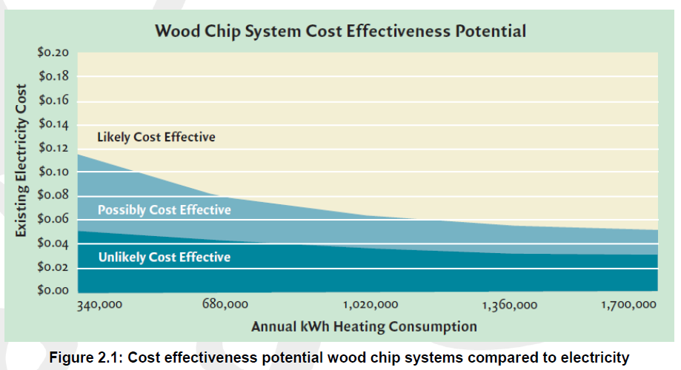
technical, economic, financial plans
Catalogue of investment opportunities
European situation of investments and cost
effectivness for different renewable energy plants

Slide 27
technical, economic, financial plans
Johann Binder Pula, 27.11.2014

